Slide 1


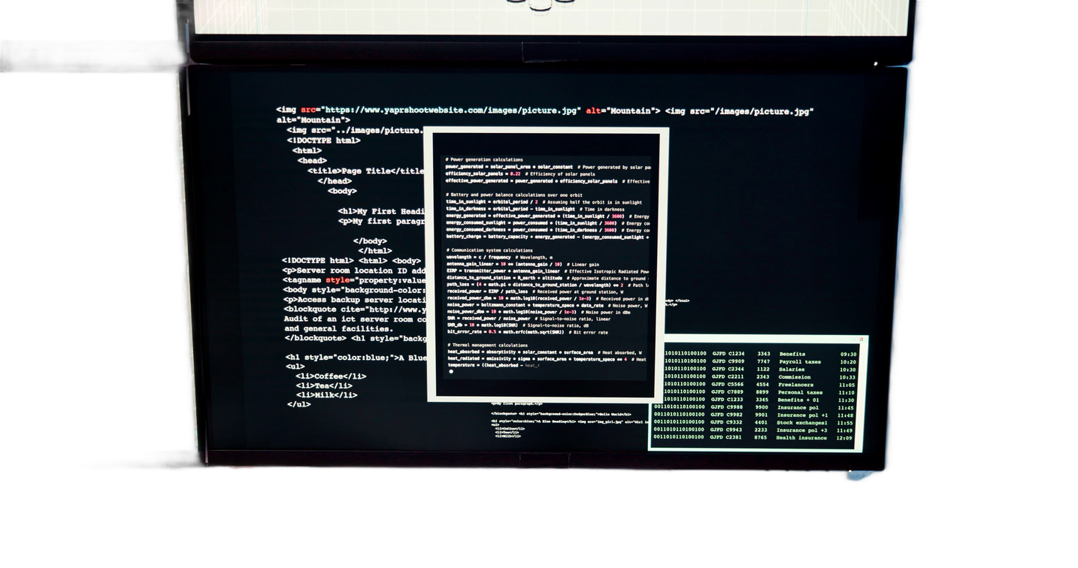


Extreme Programming (XP)
Delivering better software through continuous feedback, collaboration & rapid development.
THE XP CYCLE
Plan
→
Code
→
Test
→
Feedback
→
Improve

Slide 2

What is Extreme Programming?
A lightweight Agile method focused on delivering value fast.
Fast Development
THE FEEDBACK CYCLE
Building software in small, quick steps.
Plan
↓
Code
↓
Test
↓
Release
↓
Feedback
↓
Repeat
Continuous Feedback
Getting frequent feedback from users.
High Quality
Continuous testing ensures reliability.
Customer Collaboration
Customers stay involved throughout.
Teamwork
Close collaboration between developers.
XP = Small Releases + Continuous Testing + Customer Feedback + Team Collaboration

Slide 3




Core Values of Extreme Programming
Five principles that guide every XP team.
💬
✨
🔄
🦁
🤝
Communication
Simplicity
Feedback
Courage
Respect
Share ideas openly across the whole team.
Build only what is needed right now.
Learn quickly from real results.
Embrace change and tough decisions.
Value every team member's input.
Together, these values create trust, quality, and a healthy team culture.

Slide 4

Key Practices of XP
Pair Programming
Small Releases
Two developers work together at one screen.
Ship frequently in small increments.
Test-Driven Development (TDD)
Refactoring
Write tests before writing the code.
Improve code without changing behavior.
Continuous Integration
User Stories
Merge and test code changes often.
Capture needs from the user's point of view.
User Story → Code → Test → Refactor → Integrate → Release

Slide 5



How XP Fits with Agile & DevOps
Agile
XP
DevOps
Mindset & Framework
Development Practices
Development + Operations
Flexibility
Collaboration
Iterative development
Fast feedback
TDD
Pair Programming
Refactoring
Small Releases
Continuous Integration
Automation
CI/CD
Continuous delivery
Monitoring
Fast deployment
→
→
Agile sets the mindset, XP delivers the engineering practices, and DevOps automates delivery — together enabling fast, reliable software.

Slide 6






XP Development Cycle
User Story
Customer Feedback
Planning
XP Cycle
Small Release
Coding
Integration
Testing
XP works in short cycles instead of waiting months for one large release.
Traditional Approach
XP Approach
Plan → Develop → Test → Release (one large delivery)
Plan → Code → Test → Feedback → Improve → Release → Repeat

Slide 7

Benefits & Conclusion
BENEFITS OF XP
CONCLUSION
Higher Quality — tested, reliable code
Faster Feedback — issues caught early
Less Risk — small, safe releases
Better Teamwork — close collaboration
Easy to Adapt — welcomes change
Extreme Programming helps teams deliver better software faster. By combining continuous testing, close customer collaboration, and short feedback loops, XP reduces risk and keeps quality high — making it a strong fit for modern Agile and DevOps environments.
Build Small → Test Often → Get Feedback → Improve Continuously
Thank You

